Slide 1
ZOMATO Data Analysis Portfolio Project
Tanuja Sawant

Slide 2
Data analysis using SQL

Slide 3
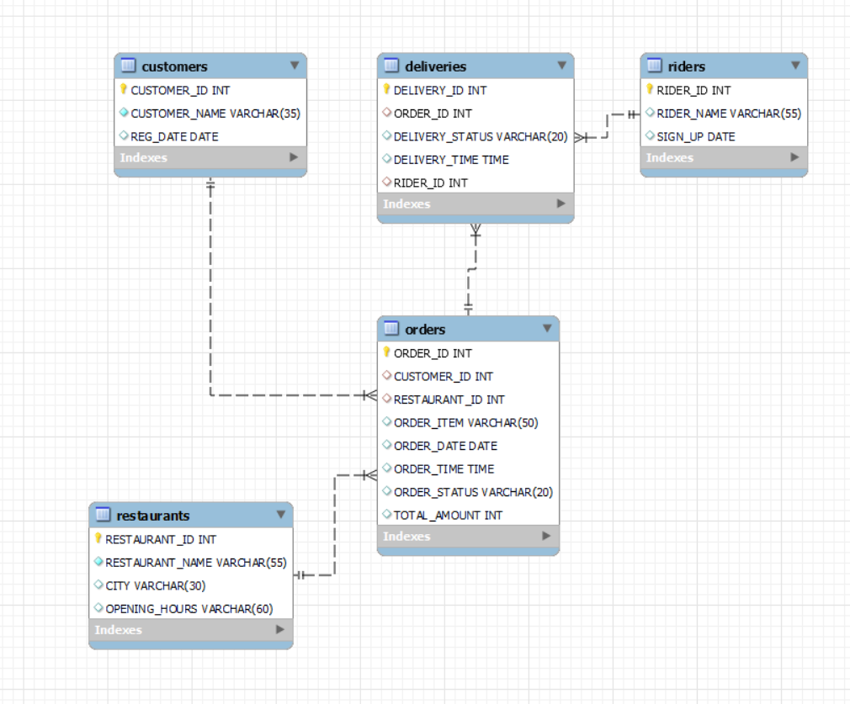
Data Model

Slide 4
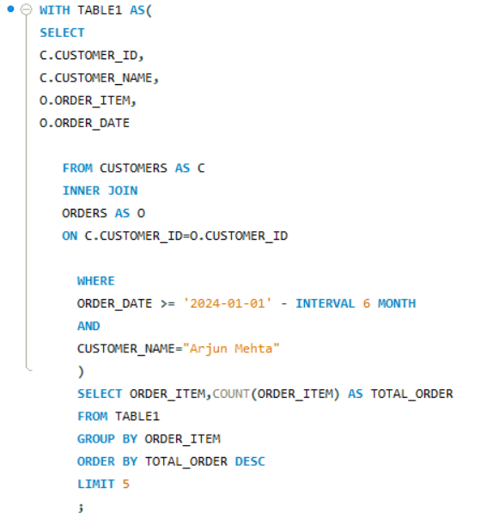
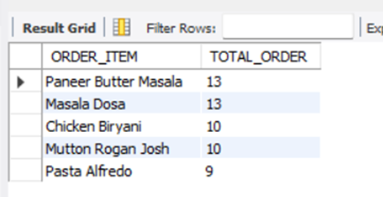
Q1.Write a query to find the top 5 most frequently ordered dishes by the customer "Arjun Mehta" in the last 6 month from date 2024-06-01

Slide 5
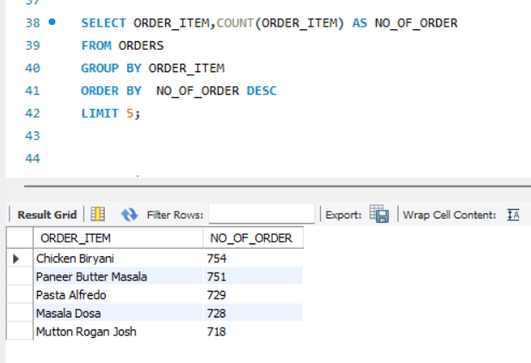
Q2. Top 5 Most Frequently Ordered Dishes

Slide 6
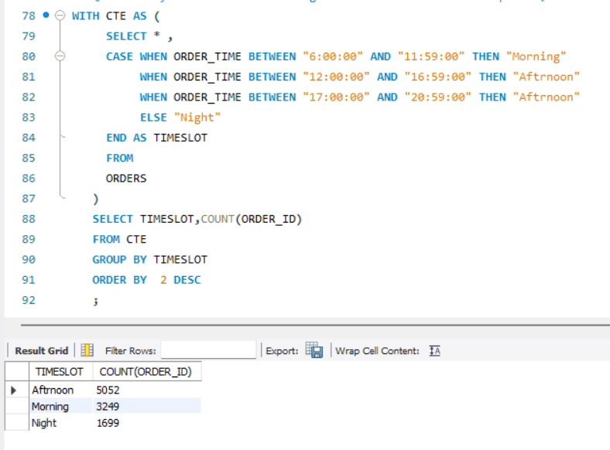
Q3 Identify the time slots during which the most orders are placed, based on intervals.

Slide 7
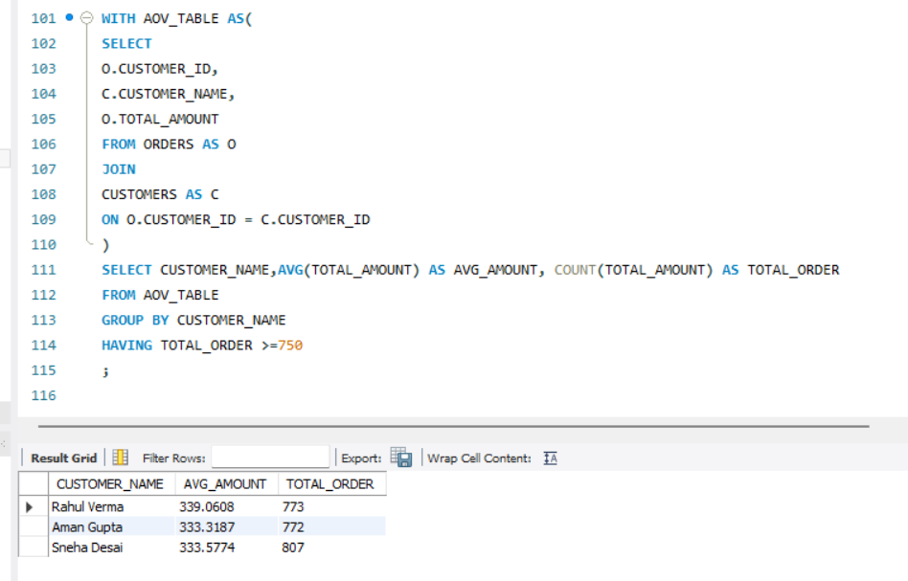
Q4 Find the average order value (AOV) per customer who has placed more than 750 orders

Slide 8
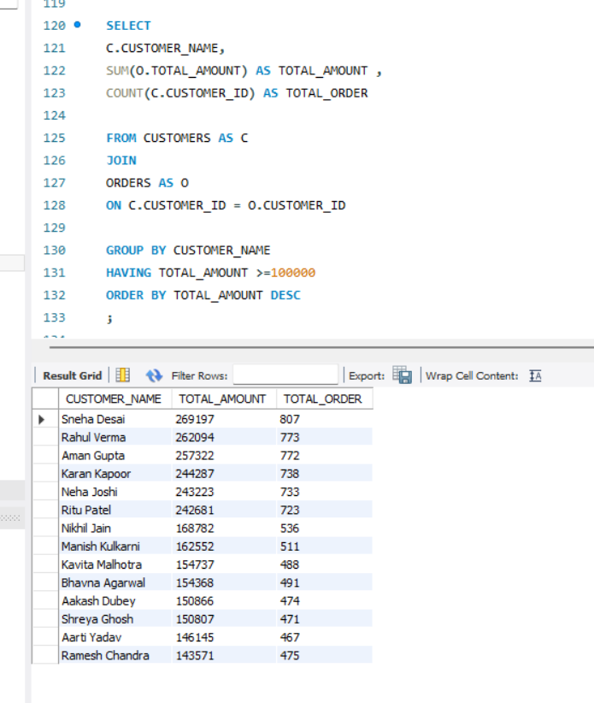
Q5 List the customers who have spent more than 100K in total on food orders.

Slide 9
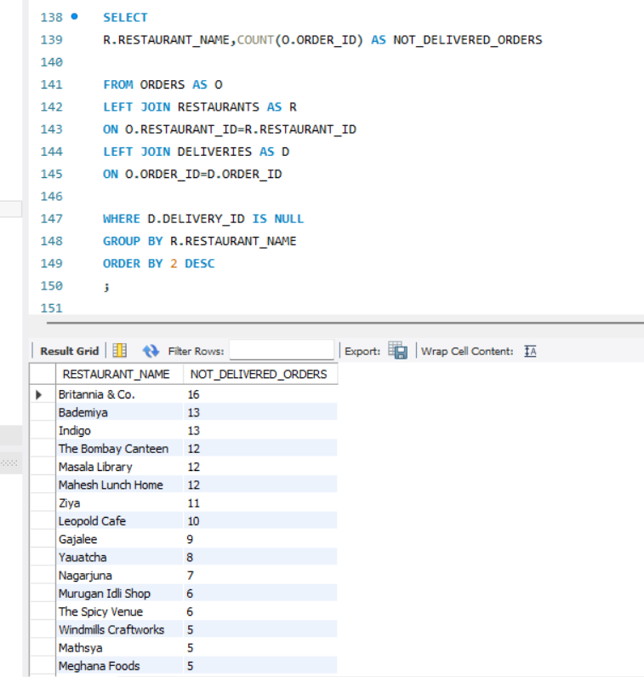
Q6 Write a query to find orders that were placed but not delivered

Slide 10
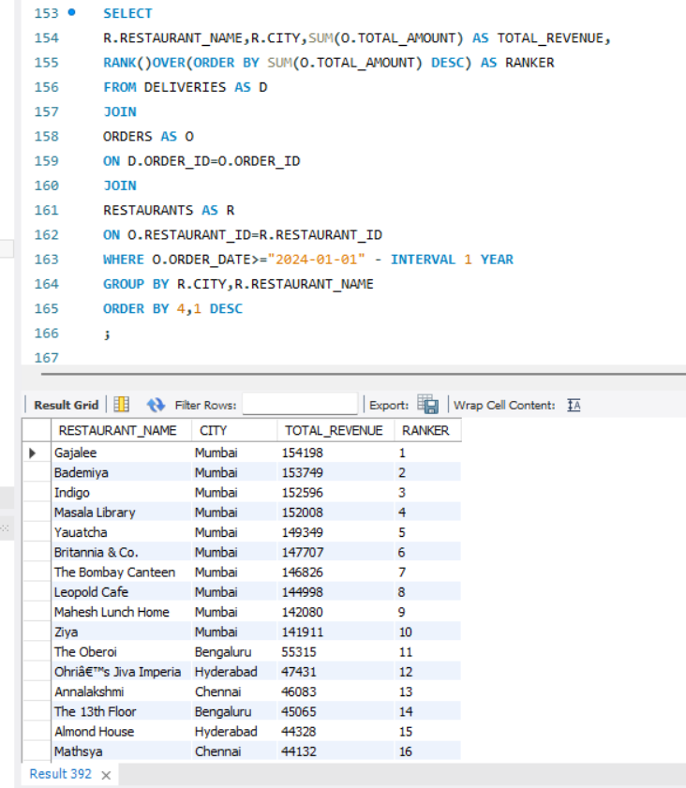
Q7 Rank restaurants by their total revenue from the last year where current date is 2024-01-01

Slide 11
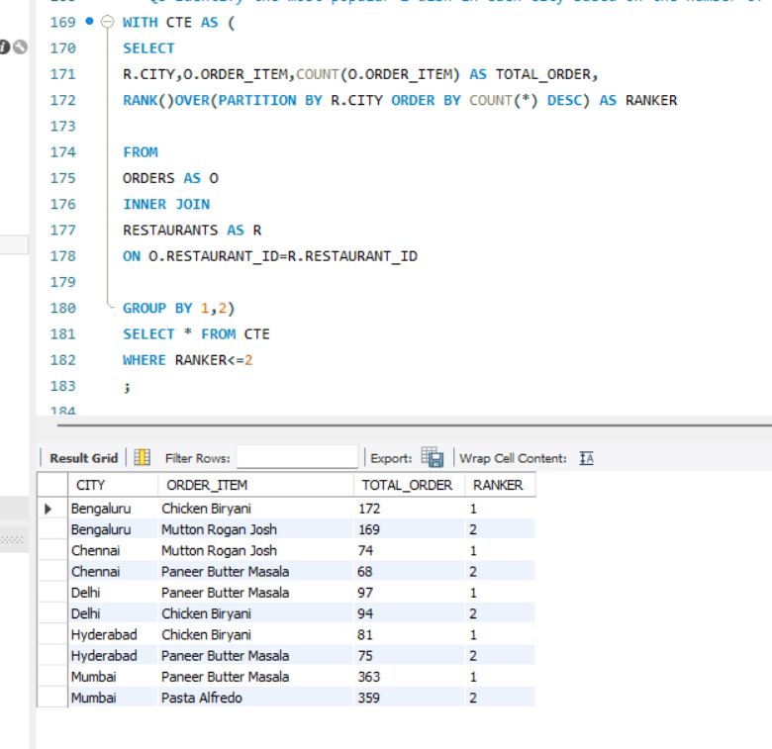
Q8 Identify the most popular 2 dish in each city based on the number of orders.

Slide 12
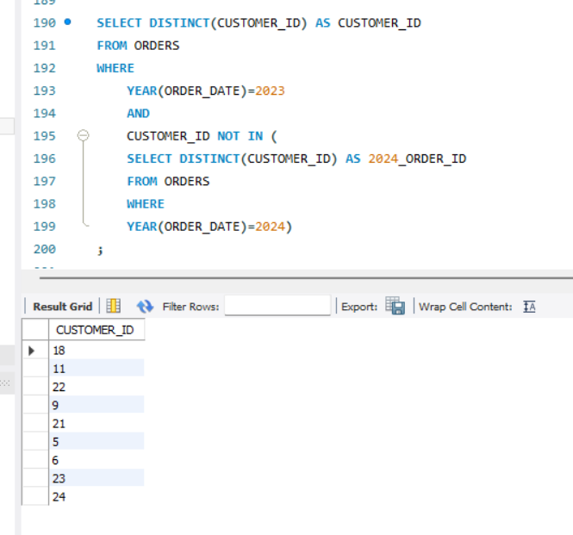
Q9 Find customers who haven’t placed an order in 2024 but did in 2023

Slide 13
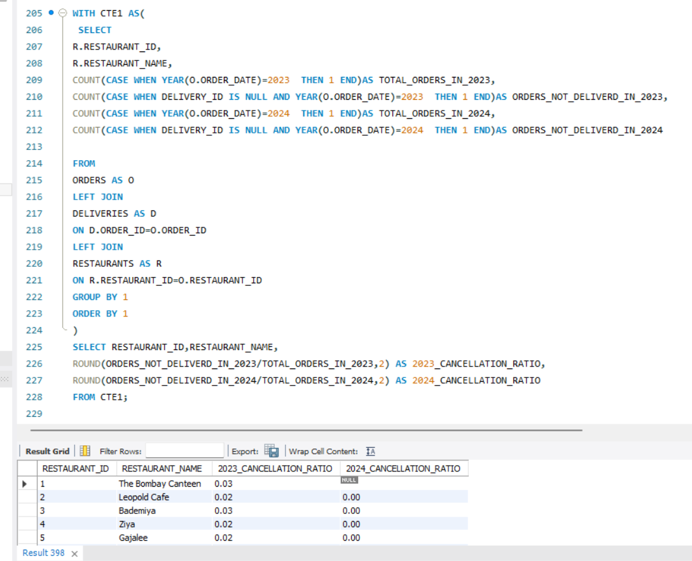
Q 10 Calculate and compare the order cancellation rate for each restaurant between the current year and the previous year

Slide 14
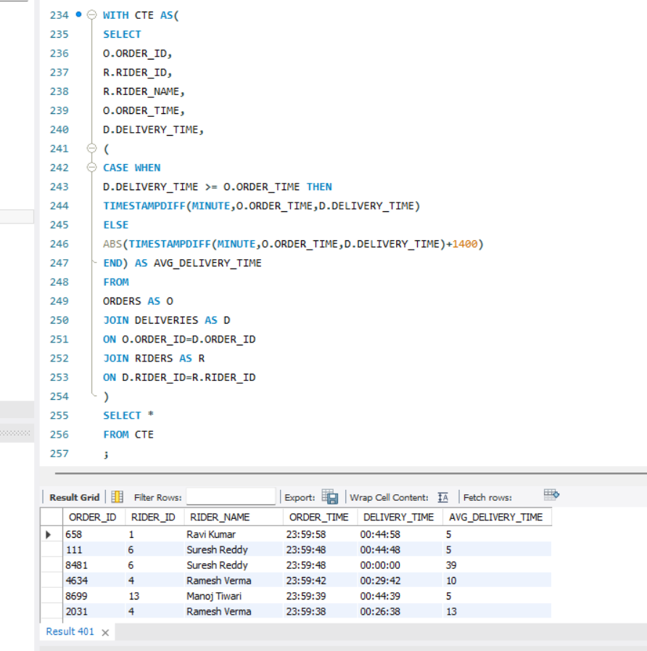
Q11 Determine each rider's average delivery time

Slide 15
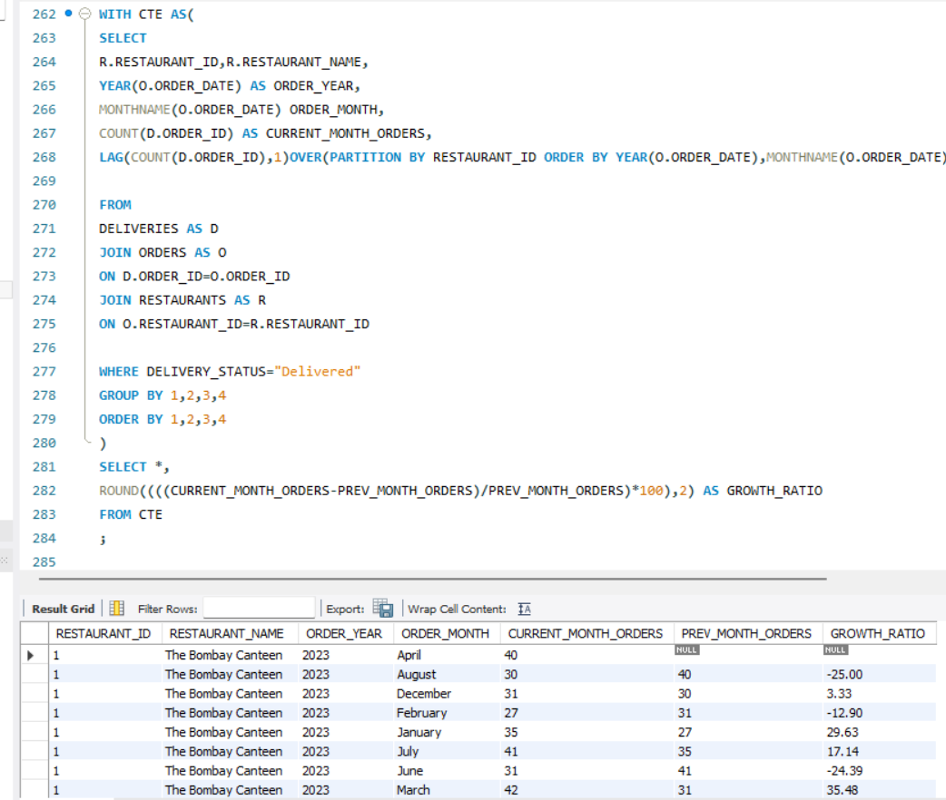
Q12. Monthly Restaurant Growth Ratio

Slide 16
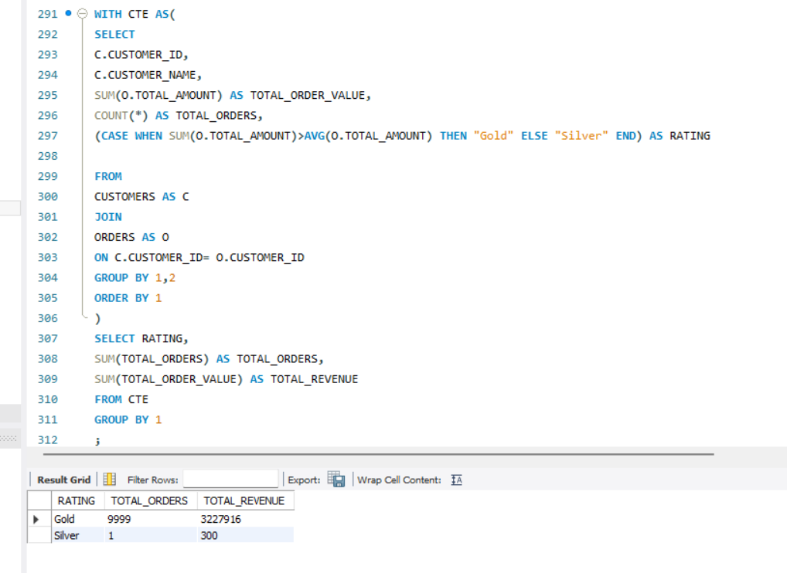
Q13 Segment customers into 'Gold' or 'Silver' groups based on their total spending compared to the average order value (AOV). If a customer's total spending exceeds the AOV, label them as 'Gold'; otherwise, label them as 'Silver'.Return: The total number of orders and total revenue for each segment.

Slide 17
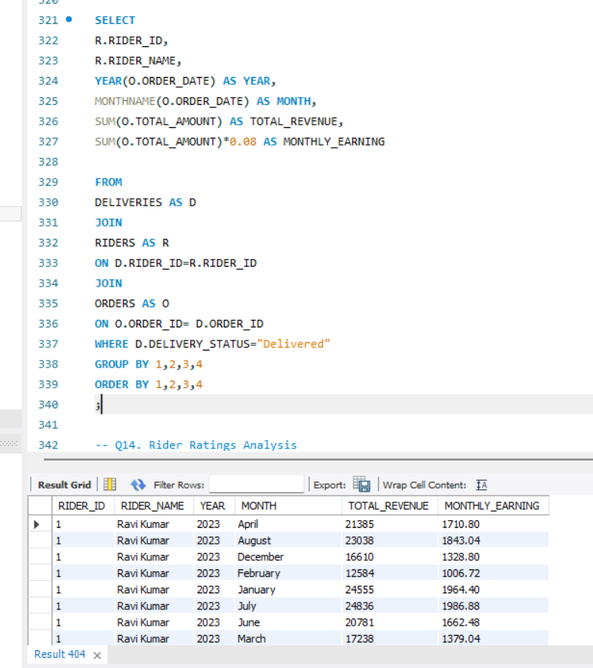
Q14 Rider Monthly Earnings Calculate each rider's total monthly earnings, assuming they earn 8% of the order amount.

Slide 18
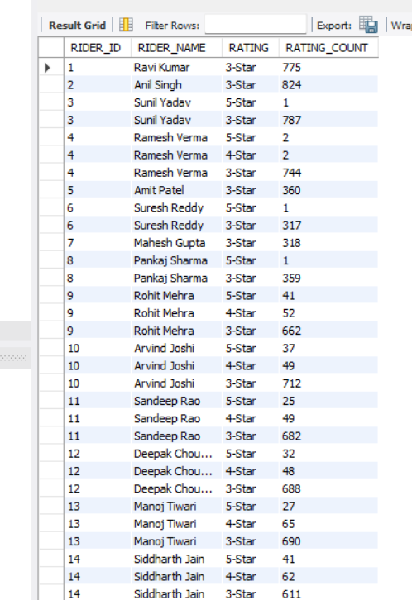
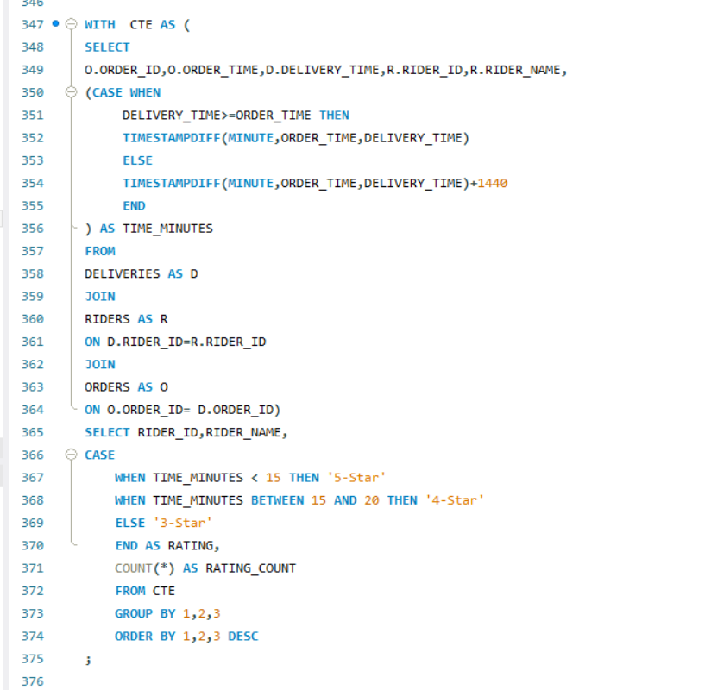
Q15. Rider Ratings Analysis Find the number of 5-star, 4-star, and 3-star ratings each rider has Riders receive ratings based on delivery time ● 5-star: Delivered in less than 15 minutes ● 4-star: Delivered between 15 and 20 minutes ● 3-star: Delivered after 20 minutes

Slide 19
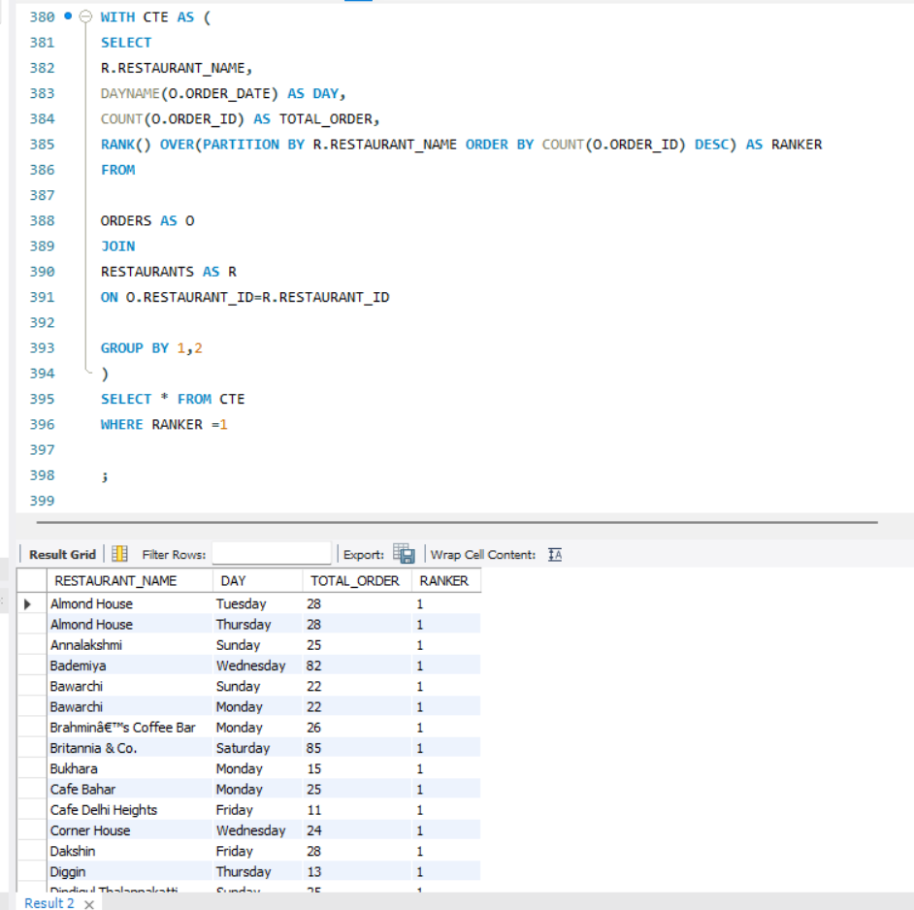
Q16. Order Frequency by Day Analyze order frequency per day of the week and identify the peak day for each restaurant.

Slide 20
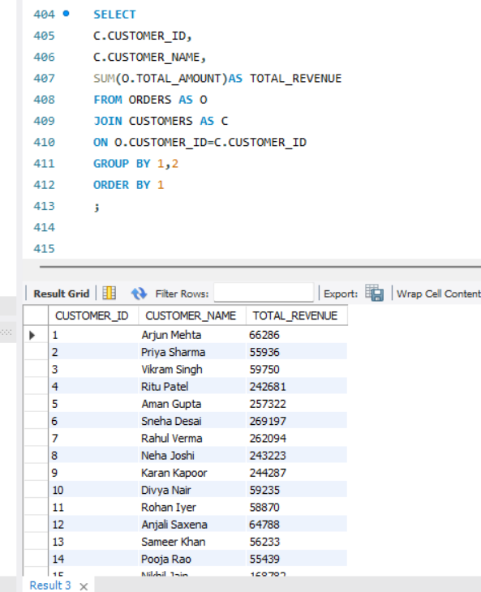
Q17 Calculate the total revenue generated by each customer over all their orders.

Slide 21
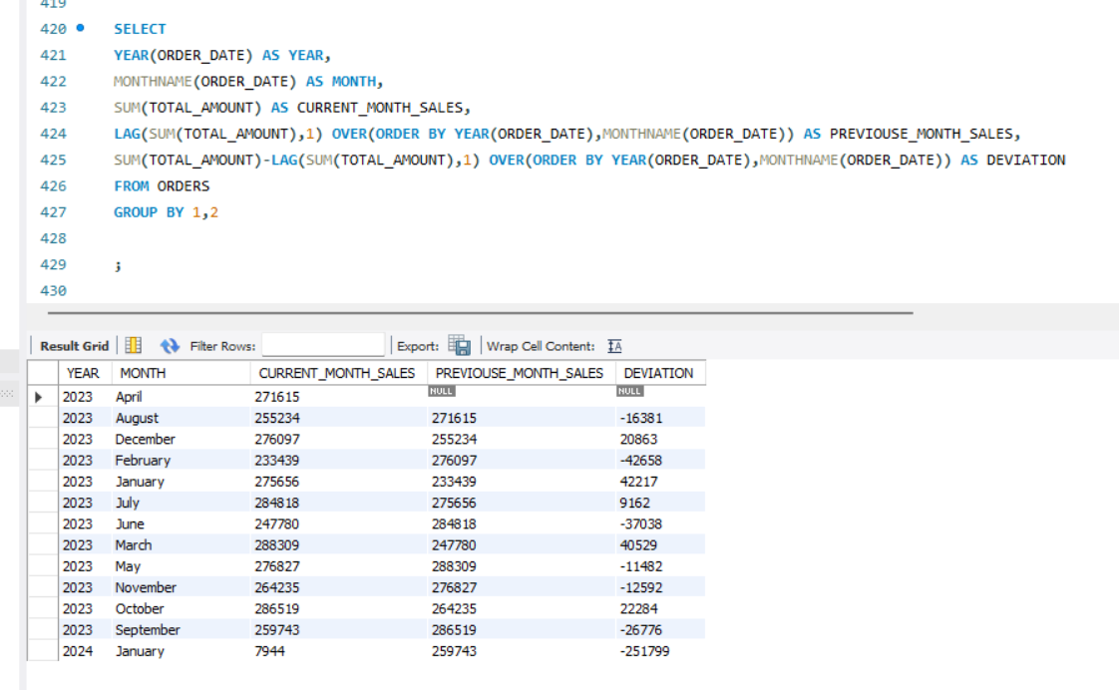
Q18. Monthly Sales Trends Identify sales trends by comparing each month's total sales to the previous month.

Slide 22
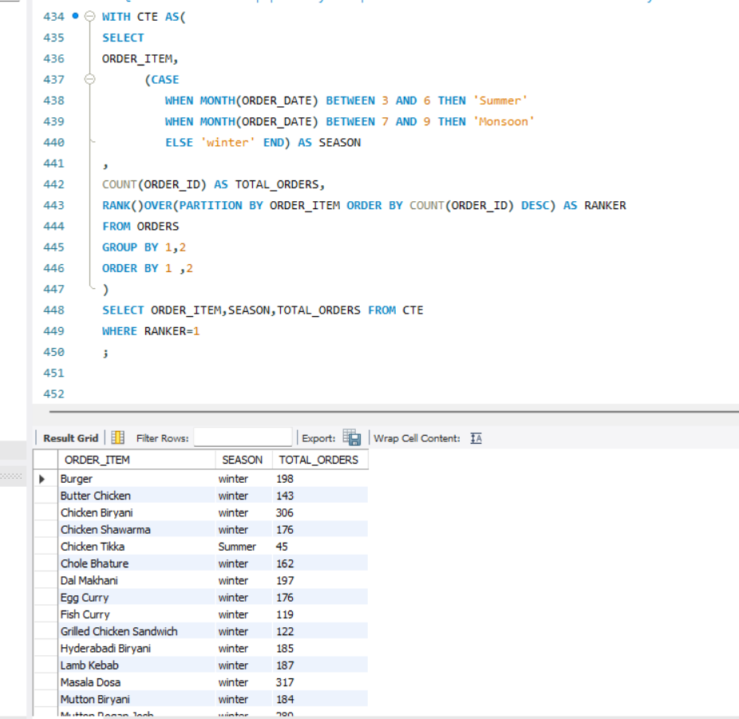
Q19 Track the popularity of specific order items over time and identify seasonal demand for each item.

Slide 23
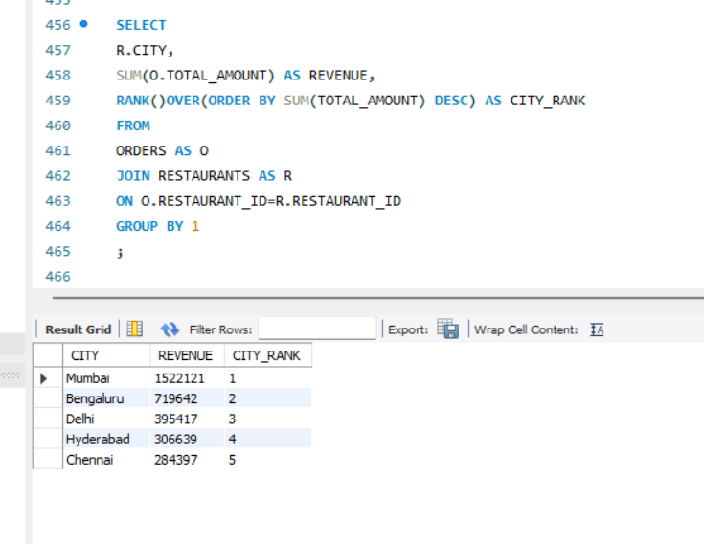
Q20 Rank each city based on the total revenue

